Slide 2
106. Increases in quality of life using novel third-wave treatment for cancer sufferers and informal cares
ACT with Mindfulness and Compassion course – A pilot for young adults diagnosed with cancer – Sari Harenwall, Danielle Wilson, Alice Bentley, Karen Verril, Lesley Howells
Compassionate Mind Training for informal caregivers of cancer patients: A pilot study – Elsa Olterman, Andreas Larsson
A Guided Internet-Based ACT Itervention for Romanian Women Diagnosed with non-metastatic breast cancer – Study protocol for a RCT – Silvia Goliţă, Adriana Băban

Slide 3
Educational objectives
(1) Describing and discussing challenges in setting up group based interventions for young adults living with persistent health problems
(2) Describing the potential benefits of Compassionate Mind Training for the psychological difficulties informal caregivers of cancer patients can experience
(3) Developing design and decision-making skill necessary in the process of building a web-based ACT intervention for a specific population

Slide 4
A Guided Internet-based Acceptance and Commitment Therapy Intervention for Romanian Women Diagnosed with non-metastatic breast cancer: study protocol for a randomized controlled trial
Silvia Goliță, Phd Student
Adriana Băban, Phd.
Department of Psychology
Babeș-Bolyai University
Cluj-Napoca, Romania

Slide 5
Disclosure – no support
Silvia Goliță & Adriana Băban - I have not received and will not receive any commercial support related to this presentation or the work presented in this presentation.

Slide 6
Overview
Romanian context
Aim of study
Metods used
(1) Recruitment
(2) Assessment
(3) Intervention protocol
Discussion

Slide 7
Romanian context
2018 – 9600 new cases of breast cancer
Survivorship rate > 60%
5 big cancer institutes, where most people get treatment
Impact:
Short and long term psychological difficulties - 2013: 42,2% clinical depression; 47,2% anxiety symptoms
Delays and disruption to social and economic opportunities

Slide 8
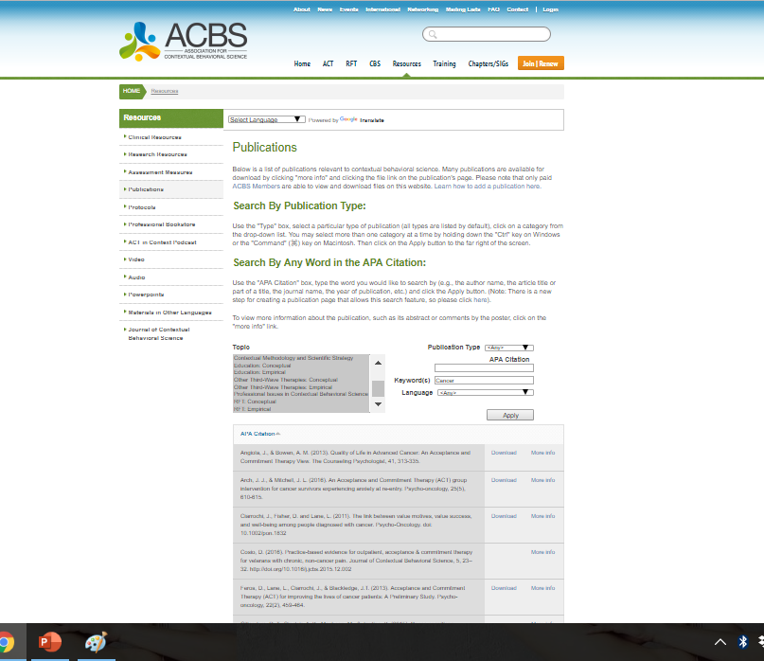
Previous studies – Cancer = 19

Slide 9
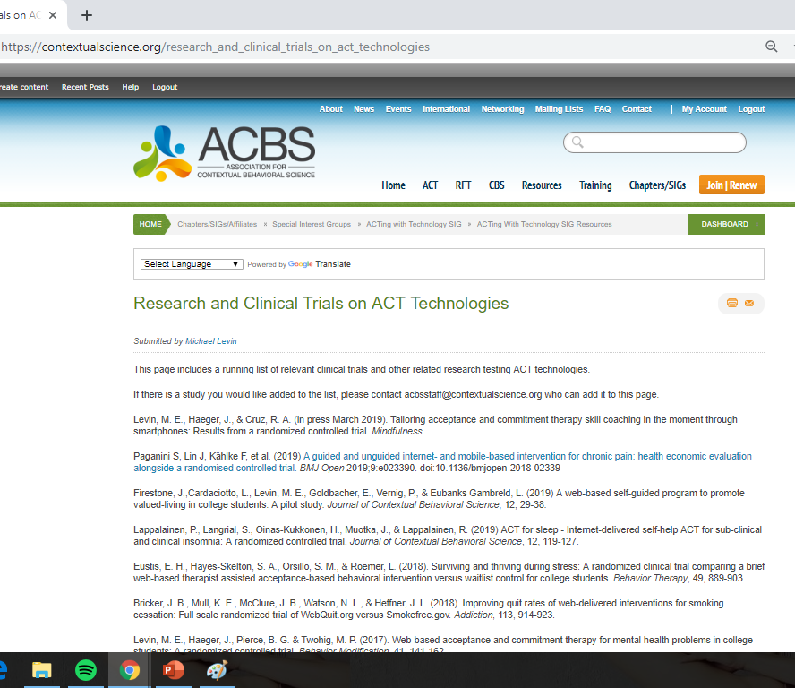
Previous studies – i-ACT > 35
https://contextualscience.org/research_and_clinical_trials_on_act_technologies

Slide 10
Oncovox
First ACT online intervention for breast cancer patients in Romania
Second ACT online intervention in Romania
www.oncovox.ro
Guided online platform containing eight ACT-consistent modules
Masters student therapists – 15min/week per participant
Content:
Text – explanations, exercises, testimonials
Audio - meditation exercises
Video – me ☺

Slide 11
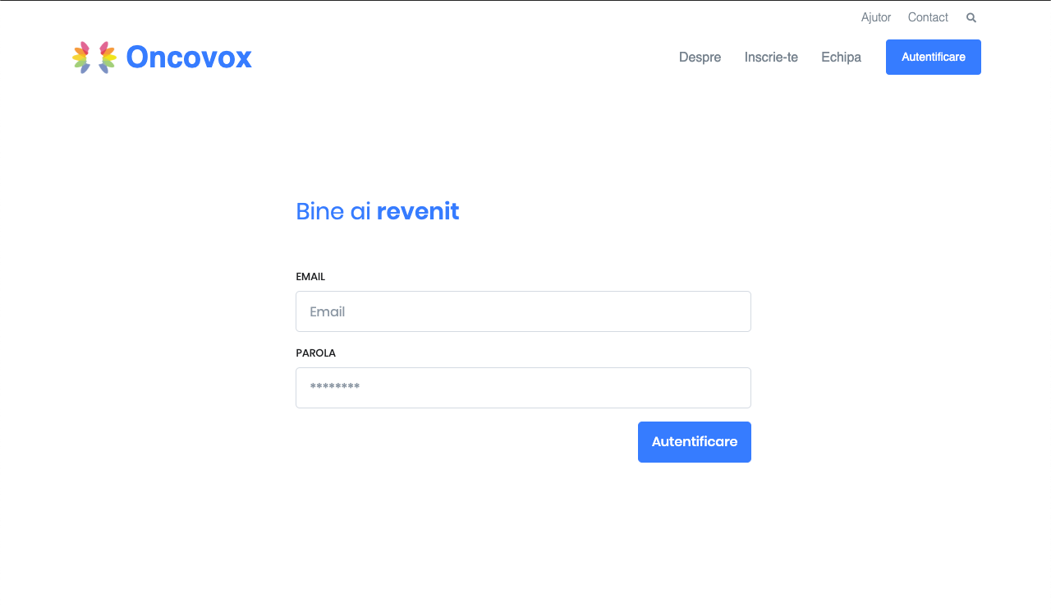

Slide 12
SR
Pilot study
RCT

Slide 13
Intervention aim
Main outcomes
Process variables
Improving quality of life
Enhancing involvement in meaningful activities
Distress
Clinical efficiency
Acceptability – openness towards online interventions
Psychological flexibility
Valued living

Slide 14
Methods – Recruitment
180 women, diagnosed with BC < 2y
Online: Facebook Ads, Facebook Communities;
Offline: NGOs, healthcare providers recommendations.
Intervention & wait list

Slide 15
Methods – Recruitment – Eligibility Criteria
Included if | Excluded if
BC diagnostic < 2y | Suicide ideation
BC = main diagnostic | Previous diagnosis of mania, bipolar disorder, psychosis, or of a learning disability
> 18 y | Already in psychotherapy
Good access to decent Internet | Psychiatric treatment modified < 3 mo
Has own email address
2-3h/week availability
Curative care

Slide 16
Methods – Assessment
Demografics & medical information
Psychological distress – Distress Thermometer, NCCN
Behavioral activation – Behavioral Activation for Depression Scale
Social involvement – Environmental Reward Observation Scale
Symptom interference – MD Anderson Symptom Inventory
Quality of life – FACT-B
Psychological Flexibility – Cancer Acceptance and Action Cancer Questionnaire
Valuing Questionnaire – idem

Slide 17
1
GDPR & informed consent
2
Create account
3
Personal & medical info (5min)
Psychological assessment (20 min)
4
Randomization – intervention group vs wait list control
5
5 – 10min phone call from psychotherapist
6
Access to intervention

Slide 18
160 consenting users
N = 80; intervention
N = 80; wait list
8 – 10 w intervention + post-assessment
18 weeks Follow up
8 w wait + post-assessment
8 – 10 w intervention + post-assessment

Slide 19
Week 1 | Assessment | Creative hoplesssness Present moment | Difficulty sleeping
Week 2 |  | Values | Nausea & fatigue
Week 3 | Assessment | Defusion | Anxiety – intrusive thoughts
Week 4 |  | Committed action | Close relationships
Week 5 |  | Acceptance Self-compassion | Body image concerns
Week 6 | Assessment | Self as context | Sexual functioning
Week 7 |  | Committed action | Changes in sense of personal identity
Week 8 | Assessment | Recap
Week 18 | Assessment | - | -

Slide 20
Week 1: Creative hopelessness. Present moment. Difficulty Sleeping
Sludge in glass metaph
Behavioral objectives
What does your mind say? Your mind is not your friend
What have you tried, how has it worked, what has it costed you?
Pushing inflatable ball in pool metaph
Mindful breathing
Sleep hygiene
Homework: (1) Mindful breating
(2) Noticing where is your mind on your timeline
(3) Mindful activities – listening to music, having tea, mindful walking
(4) Meditation for sleep

Slide 21
Week 2: Values. Nausea, fatigue
Distinguishing values from goals
Bull`s eye exercise
70-year birthday speech
Personal heroes
Homework: (1) Salt & pepper
(2) Mindful Breathing (10min)

Slide 22
Week 3: Defusion. Anxiety, intrusive thoughts
Your mind is not your friend
Radio Doom & Goom = Radio Romania Catastrofa
What story is your mind giving you?
Moving you towards or away?
Noticing & naming & anchoring
Play in Word → difficult words like cancer, hospital, breast.
Flat tire metaphor
Leaves on a stream
Homework: (1) Jar of thoughts
(2) Practice naming the story & anchoring
(3) Salt & Pepper
(4) Mindful breathing

Slide 23
Week 4: Committed Action. Close relationships
Trying vs doing
Towards or away?
Gradual goal setting
Feeding the puppy that turns into wolf metaph
Homework: (1) Salt & pepper – for valued relationships
(2) Notice, name & anchor
(3) Body scan & mindful breathing exercise

Slide 24
Week 5: Acceptance. Self-Compassion. Body image concerns
Passengers on a bus
Acceptance exercise – opening, breathing in, curiosity
Joe the bum
Hand on heart exercise
Homework: (1) Salt & pepper
(2) Mindful breathing & body scan
(3) Hand on heart exercise

Slide 25
Week 6: Self as context. Sexual functioning
Chess board metaph
Observer self exercise
Notice labels – sick, cancer patient
Away vs towards goals/values?
Documentary about Africa vs going to Africa metaph
Homework: (1) Salt & pepper
(2) Mindful breathing & body scan
(3) Observer self

Slide 26
Week 7: Committed action. Changes in sense of personal identity
Bull`s eye – connect to values about self
What story is your mind giving you?
Mindful mirror exercise
Commitment to valued living worksheet
Barriers to values – coping cards
Homework: (1) Salt & pepper
(2) Mindful breathing & body scan

Slide 27
Week 8: Bringing it all togheter
Checking behavioral goals set in the beginning
Wiser self meditation
Bull`s eye exercise
FEAR or DARE exercise
List of exercises
Homework: (1) Salt & pepper
(2) Mindful breathing & body scan

Slide 28
Results … in 2020/21
Effectiveness
Mechanism of change
Acceptability
Usage analysis

Slide 29
Data analysis
Group comparison (independent T test) & growth curve analysis
Moderation: initial distress level; initial health status; clinical stage of treatment
Mediation: psychological flexibility

Slide 30
Thank you!
Silvia Goliță, Phd Student
silviagolita@psychology.ro
Department of Psychology
Babeș-Bolyai University
Cluj-Napoca, Romania

